Slide 1
Vhost Zero-copy Best Practice
Marvin-Intel NPG

Slide 2
Agenda
Vhost Dequeue zero-copy introduction
VM2NIC Best Practice
VM2VM Best Practice
NUMA Best Practice

Slide 3
VM2NIC
GUEST
VIRTIO
AVAIL
DESC
KVM
VHOST
AVAIL
HOST
DESC
eventFD
COPY
MBUF
RXQ
TXQ
NIC

Slide 4
VM2NIC Dequeue zero-copy
VHOST
USED
AVAIL
DESC
HOLD
ZMBUF
NIC
RXQ
TXQ

Slide 5

VM2NIC Best Practice
Resource competition
Limitation:
zero copy not work when bonding to vfio-pci with iommu mode

Slide 6
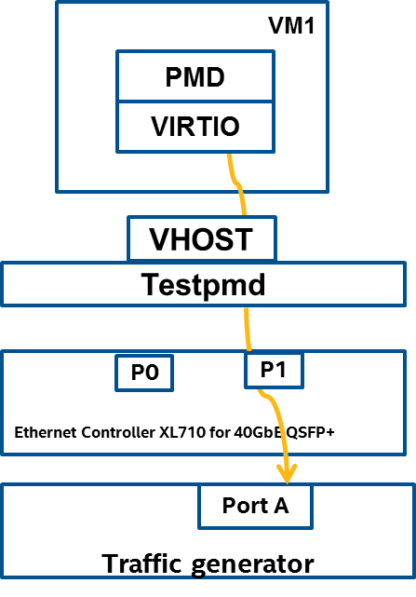
VM2NIC Best Practice
Tips
VIRTIO queue size = NIC queue size
Free threshold = TXD –burst size

Slide 7
VM2NIC Best Practice

Slide 8
VM2VM De-queue zero-copy
GUEST0
AVAIL
GUEST1
USED
DESC
DESC
IRQFD
VHOST
AVAIL
USED
KVM
DESC
DESC
eventFD
HOLD
COPY
ZMBUF

Slide 9
VM2VM Best Practice

Slide 10
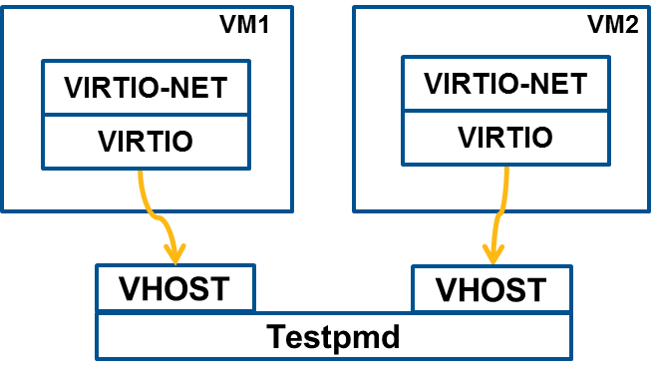
VM2VM Best Practice

Slide 11
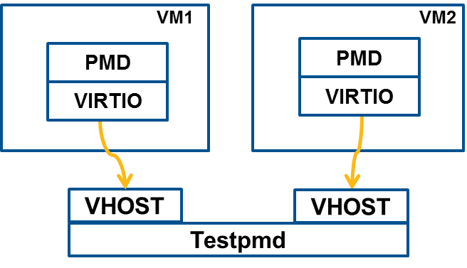
VM2VM Best Practice
Enable VIRTIO_F_ANY_LAYOUT for better performance
DPDK 18.02
Perf improvement
With ANY_LAYOUT | Without ANY_LAYOUT
13.9Mpps | 12.9Mpps

Slide 12
NUMA Best Practice
CPU and Memory elements
CPU VHOST
QPI
CPU VIRTIO
VHOST & VIRTIO CPU
VHOST VQ and MP
VHOST DESC/AVAIL/USE Ring
VIRTIO VQ
VIRTIO DESC/AVAIL/USE Ring
VQ
VQ
DESC | AVAIL | USED
DESC | AVAIL | USED
MP

Slide 13
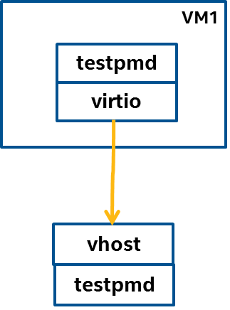
NUMA Best Practice
CPU node has the dominate effect on performance
Zero copy will be better when CPUs on different nodes
 | CPU same node Memory same node Zero copy | CPU same node Memory cross QPI Zero copy | CPU cross QPI Memory same node Default | CPU cross QPI Memory cross QPI Zero copy | CPU cross QPI Memory same node Zero copy
Throughput | 9.0Mpps | 8.9Mpps | 3.1Mpps | 4.9Mpps | 5.0Mpps
VHOST cache miss/Sec | 2K | 4K | 21M | 8M | 7M

Slide 14
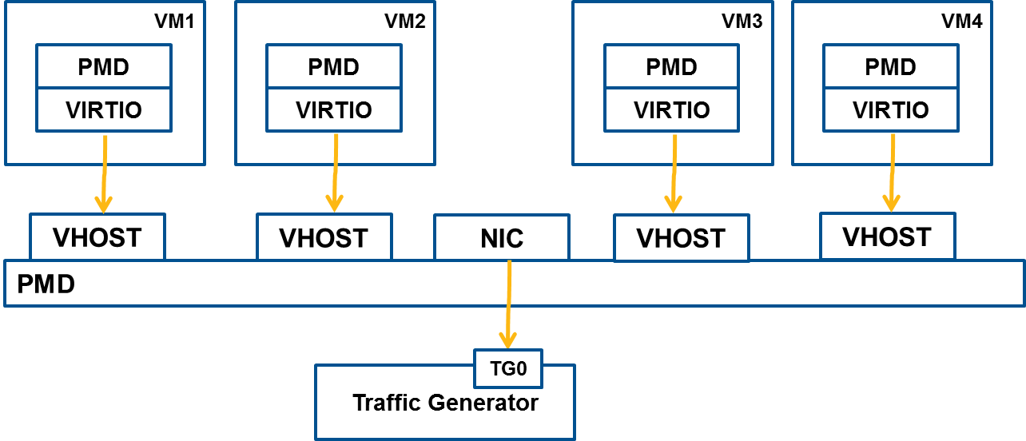
NUMA Best Practice
NIC cross QPI better than CPU cross QPI
 | CPU same node NIC cross QPI Zero copy | CPU cross QPI NIC same node Zero copy
NIC Throughput | 11.3Mpps | 10.1Mpps
VHOST cache miss/sec | 350K | 15M

Slide 15
Thanks

